Slide 1
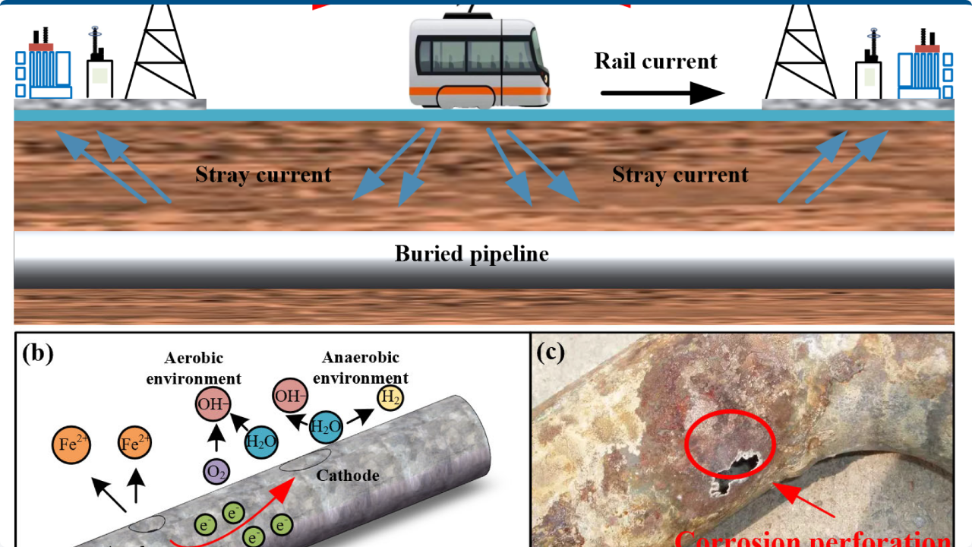

Data-Driven Corrosion Inhibitor Modeling
Pipeline Progress Report

Slide 2


Goal & Context
Objective
Build a predictive model for Inhibition Efficiency (IE) to optimize inhibitor structures and dosages.
The Dataset
•
~300 Lab Runs: Comprehensive experimental data.
•
Key Descriptors: Formulation (C#, Mw, HLB, EO) & Conditions (Conc, pH).
•
Strategy: Dual-file approach (Original vs. Fixed pH 4.9) to isolate sensitivity.

Slide 3





Preprocessing & Cleaning Workflow
Cleaning
Calculation
Splitting
Removed redundant columns, duplicates, and empty rows. Normalized "Unnamed" entries to ensure data integrity.
Applied domain logic: IE = IE × AA / 100. Rescaled Inhibition Efficiency using Active Agent (AA) factor.
Partitioned into Train (70%), Validation (15%), and Test (15%) sets. Applied train-only mean imputation and standard scaling.

Slide 4
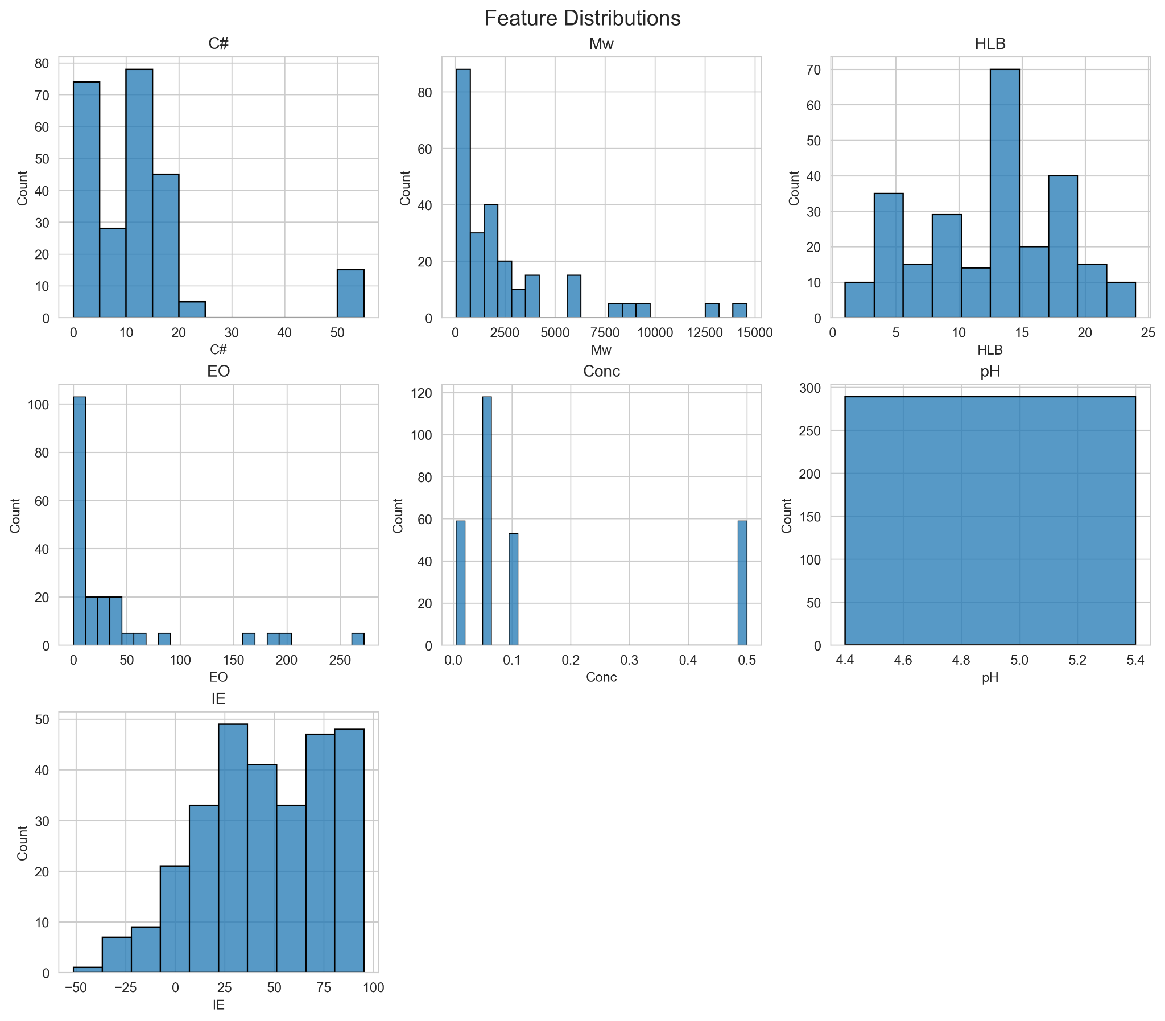

Exploratory Data Analysis: Distributions
Key Findings
•
IE Range: Spans from -52% to ~95%, with a median around 51%. This wide variance confirms the need for robust modeling.
•
pH Factor: The histogram for pH collapses to a single bar at 4.9 in the current working copy, confirming the successful isolation of this variable for sensitivity analysis.
•
Feature Coverage: Formulation features cover expected ranges (e.g., C# 0–55).

Slide 5
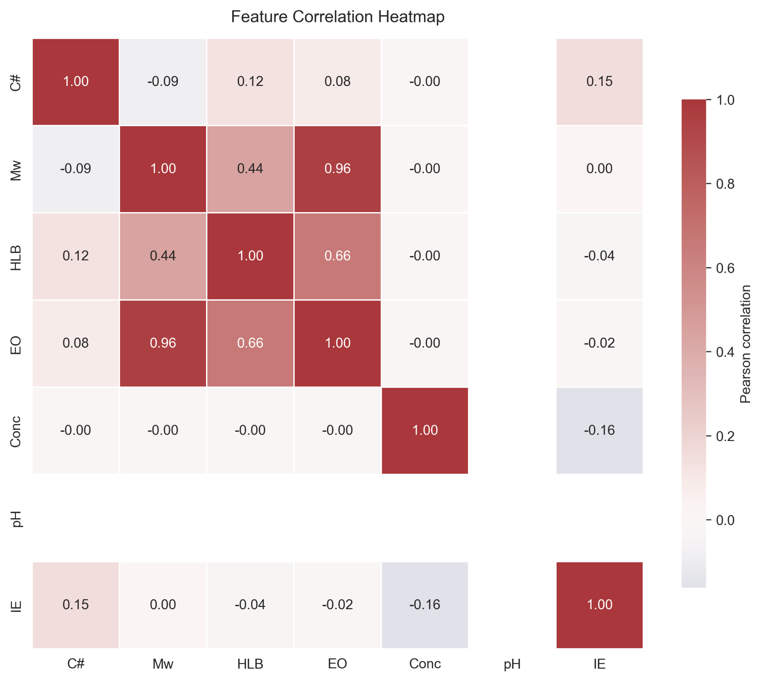
Exploratory Data Analysis: Correlations
Pearson Correlation Insights
The heatmap reveals critical linear relationships:
•
Positive Correlation: Carbon Number (C#) shows a slight positive link to IE (~0.17).
•
Negative Correlation: Concentration (Conc) negatively correlates with IE (~ -0.16).
•
Non-Linearity: Weak linear correlations across other features suggest complex, non-linear interactions that simple models may miss.

Slide 6


Feature Engineering & Loaders
Canonical Feature Set
Pipeline Infrastructure
We have locked the feature list for consistency across all models:
features.load_splits(): A centralized function that pulls pre-processed (X_train, y_train) triples.
•
Carbon Number (C#)
Automation: Automatically regenerates processed CSVs if missing, ensuring downstream scripts remain clean and stateless.
•
Molecular Weight (Mw)
•
HLB Value
•
Ethylene Oxide (EO)
•
Concentration (Conc)
•
pH Level

Slide 7
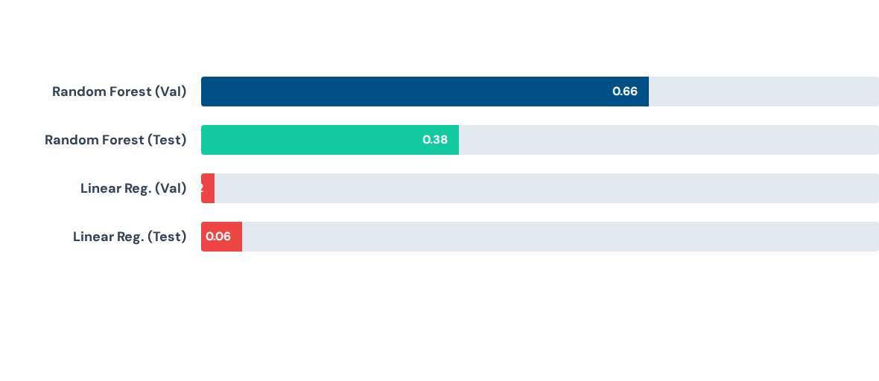
Baseline Model Performance (R²)
The huge gap between Random Forest and Linear Regression confirms strong non-linear effects.

Slide 8
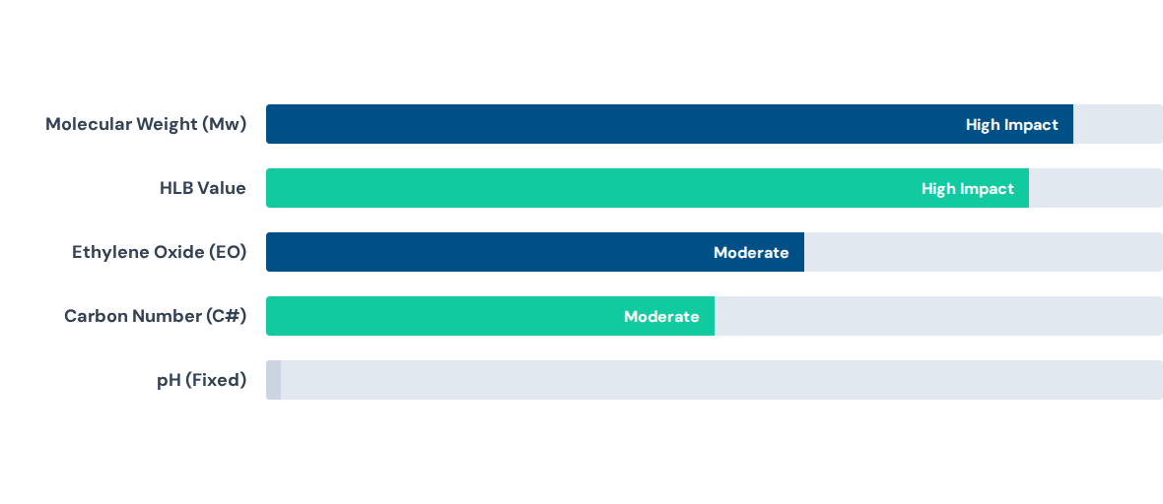
Feature Importance Ranking

Slide 9
Project Roadmap
Model Selection
Evaluation
Optimization
Compare Gradient Boosting, Elastic Net, and SVR. Tune hyperparameters for both original and constant-pH scenarios.
Report MAE/RMSE metrics. Generate SHAP plots to interpret complex non-linear feature interactions.
Translate the best performing model into a tool for recommending optimal inhibitor structures and dosages.

